Slide 1
Quick Recap
Your meetings, summarized in seconds.
By : Team 2 Bros of Balayya

Slide 2
Agenda
Problem Statement | 8. Figma Design
2. Project Description | 9. Diagrams
3. Persona | 10. Sprint 1 Recap
4. MVP | 11. Burndown Charts
5. Technologies & Algorithm | 12. Sprint Retrospective
6. Project Schedule | 13. Project Demo
7. Teamwork Agreement

Slide 3
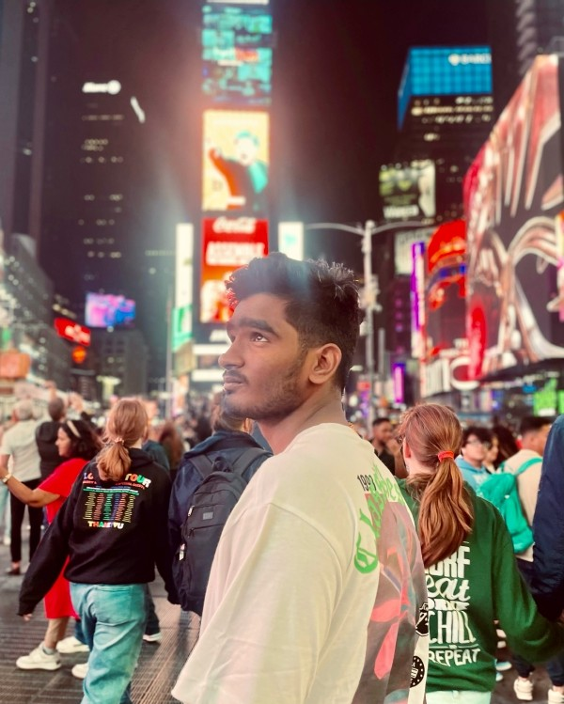

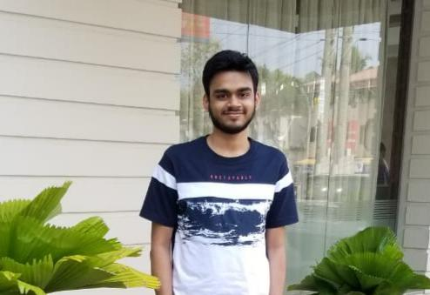
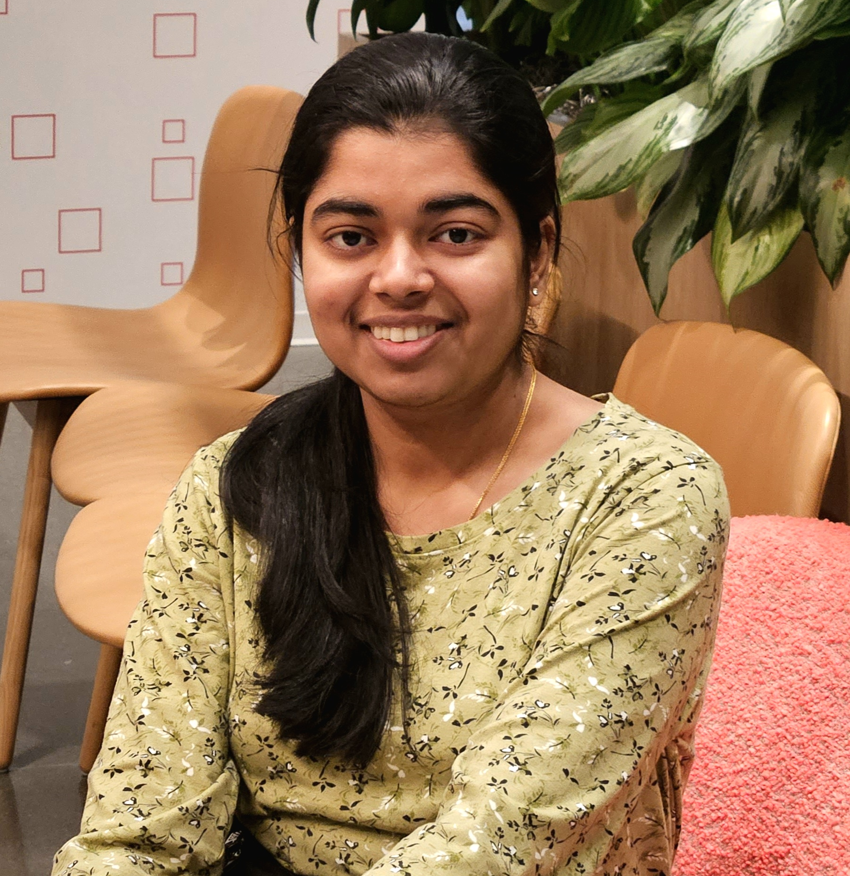
Roles & Responsibilities
Naveen Nayak Team Lead/ Backend Engineer
Navya Nayak ML Engineer/ Scrum Master
Madhu Kiran Frontend Engineer

Slide 4
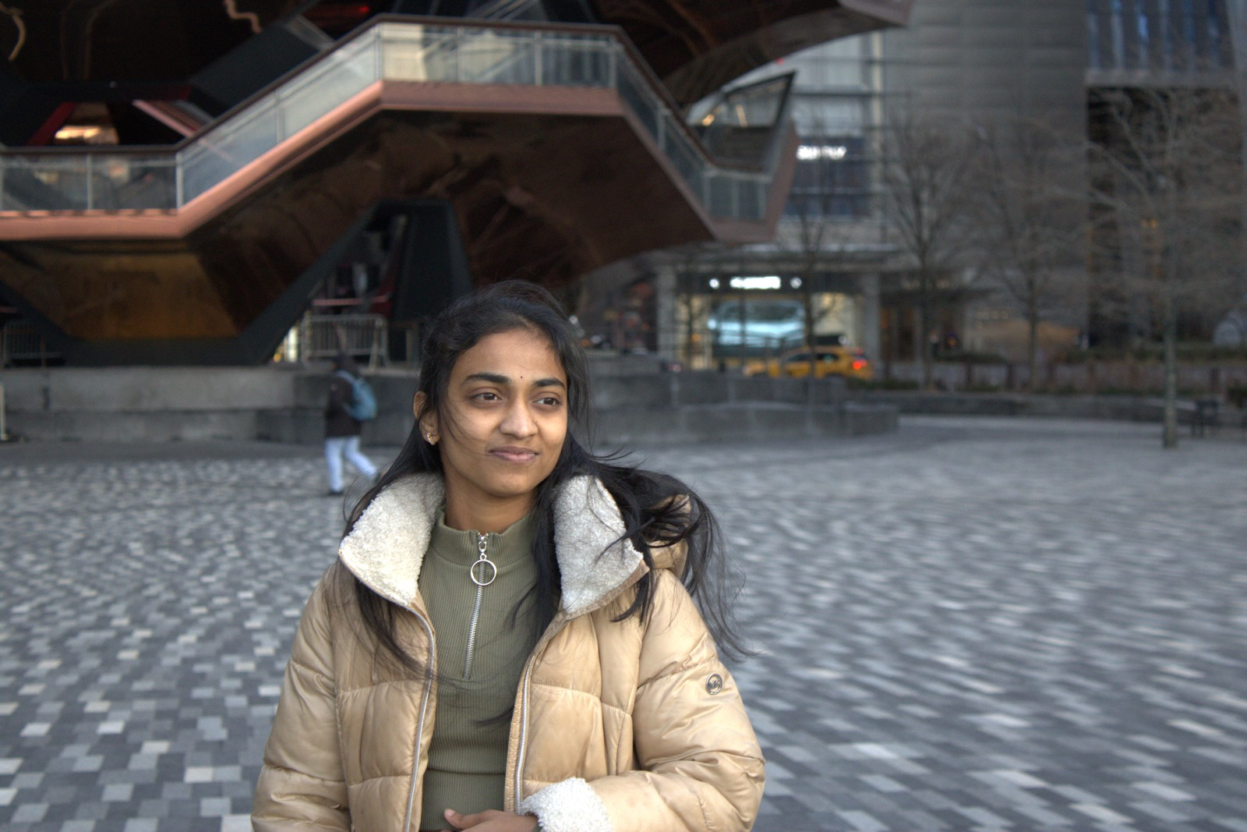
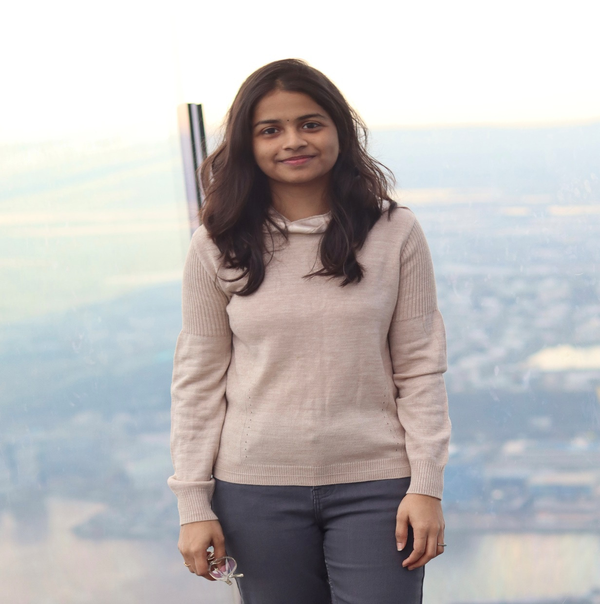
Roles & Responsibilities
Saranya Chandu ML Engineer
Aakruthi Reddy Frontend Engineer

Slide 5

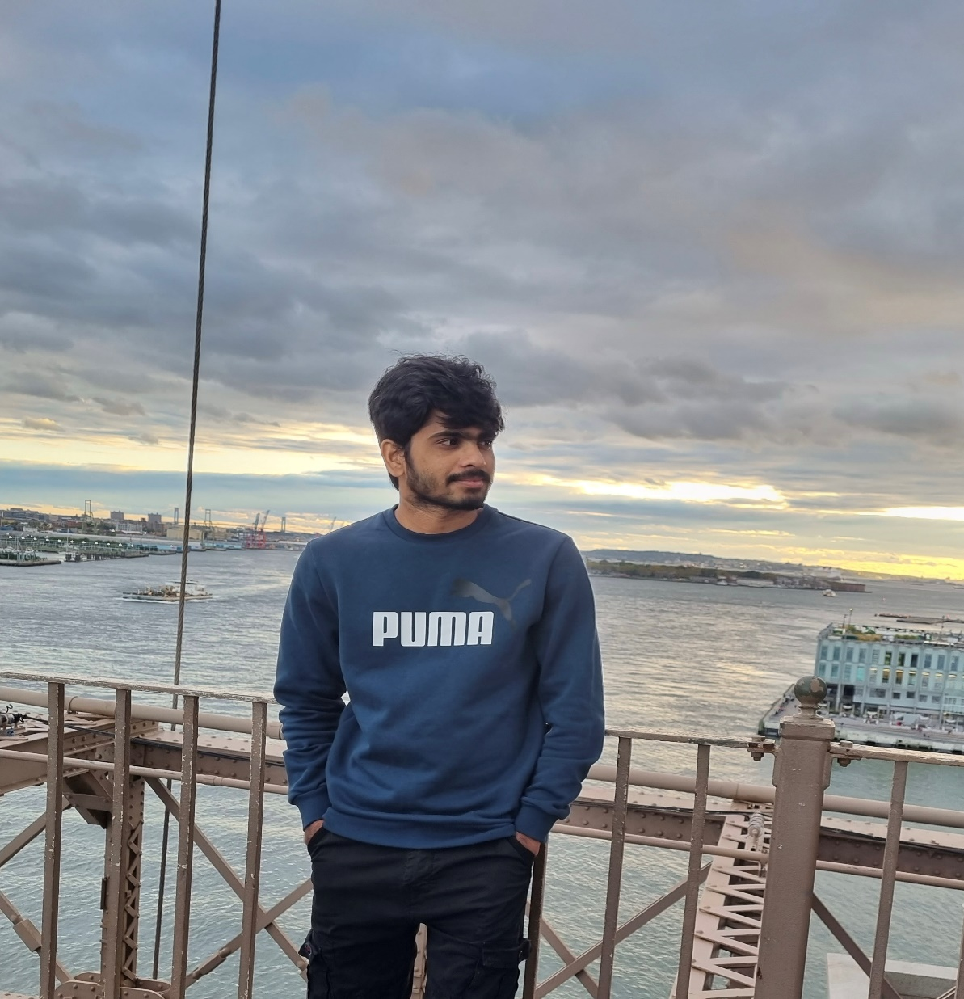
Roles & Responsibilities
Brunai Developer
Vishwas Mamidi Developer/ QA

Slide 6
Improvements made from Feedback
We had a detailed retrospective of what went well, what can be improved and action items assigned to the team members
Detailed project schedule

Slide 7
Meetings are essential, but reviewing recordings and notes is time-consuming and often inefficient. Quick Recap solves this problem by providing personalized, AI-powered summaries of meetings, saving users time and maximizing the value of meeting content.
Problem Statement

Slide 8
Project Description
Web application for enhanced meeting productivity.
Provides personalized summaries of meeting recordings.
Employs natural language processing (NLP) for summary generation.
Highlights the most relevant information based on user profiles.
Enables users to quickly grasp key takeaways without reviewing lengthy recordings.

Slide 9

Persona – Project Manager
Isabelle is a high-level executive at a fast-growing tech company. She's intelligent, driven, and constantly juggling multiple projects and responsibilities.
Challenges:
Attends numerous meetings daily, often back-to-back.
Struggles to recall key decisions, action items, and strategic discussions from past meetings.
Lacks time to review lengthy meeting recordings or detailed notes.
Goals:
Quickly identify action items and delegate tasks effectively.
Make informed decisions based on accurate and concise meeting information.
Reclaim valuable time spent reviewing meeting content.
Name: Isabelle
Age: 48
Gender: Female
Occupation: Project Manager

Slide 10

Persona - Journalist
Lena is an investigative journalist who conducts numerous interviews for her stories. She needs to accurately transcribe and analyze these interviews to extract key information and build her narratives.
Challenges:
Spends countless hours transcribing interviews, which takes away from her research and writing time.
Requires accurate transcriptions to ensure the integrity of her reporting.
Finds it difficult to organize and manage a large number of interview recordings.
Goals:
Quickly and accurately transcribe interviews.
Improve her research and writing workflow..
Efficiently extract key quotes and information.
Name: Lena
Age: 28
Gender: Female
Occupation: Journalist

Slide 11
Persona - Student
Carlos is a highly motivated university student pursuing a demanding degree in engineering. He's dedicated to his studies but often finds himself overwhelmed by the volume of information presented in lectures and seminars.
Challenges:
Struggles to keep up with the fast pace of lectures and take comprehensive notes.
Finds it difficult to identify the most important concepts and takeaways from lectures.
Needs a more efficient way to organize and review lecture material.
Goals:
Easily find specific information discussed in lectures.
Create concise and organized notes from lectures without having to rewatch everything.
Improve his overall learning efficiency and academic performance.
Name: Carlos
Age: 22
Gender: Male
Occupation: Engineering Student

Slide 12
Upload audio/video files
Automatic transcription via speech-to-text
Basic user profiles (role, interests)
Personalized summaries based on user profiles
Core summarization algorithm
User-friendly web interface.
MVP Product

Slide 13






Technologies
REACT
JavaScript
Python
Firebase
Jira
GitHub

Slide 14





Workflow
Upload
Speech to text
Personalization
Summarization
Display

Slide 15
Project Schedule
Sprint 0 Feb 11
Sprint 1 Mar 11
Sprint 2 Apr 8
Sprint 3 Apr 29
Sprint 0 | Sprint 1 | Sprint 2 | Sprint 3
Daliy Scrum call | Daliy Scrum call | Daliy Scrum call | Daliy Scrum call
Sprint Retrospective | Sprint Planning | Sprint Planning | Sprint Planning
 | Sprint Retrospective | Sprint Retrospective | Sprint Retrospective
 | Product development (Frontend, ML model, Backend) | Product development (Integration of components) | Final Product development

Slide 16
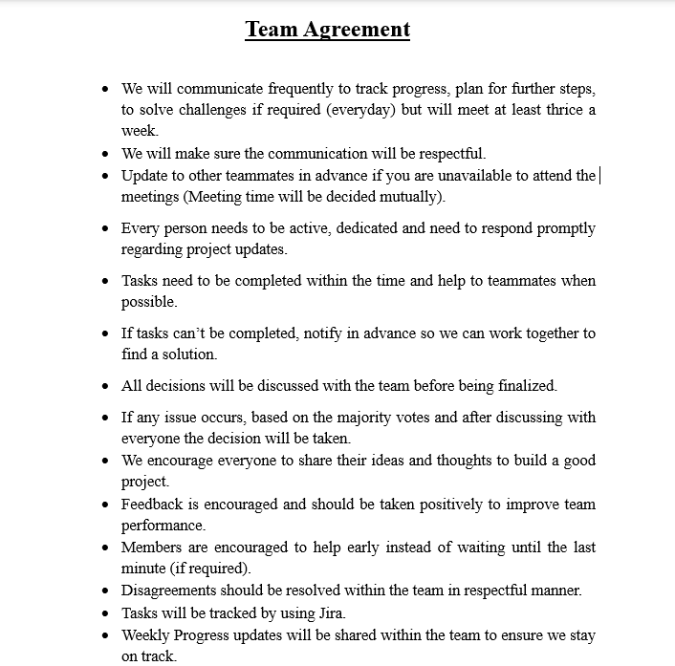
Team Working Agreement

Slide 17
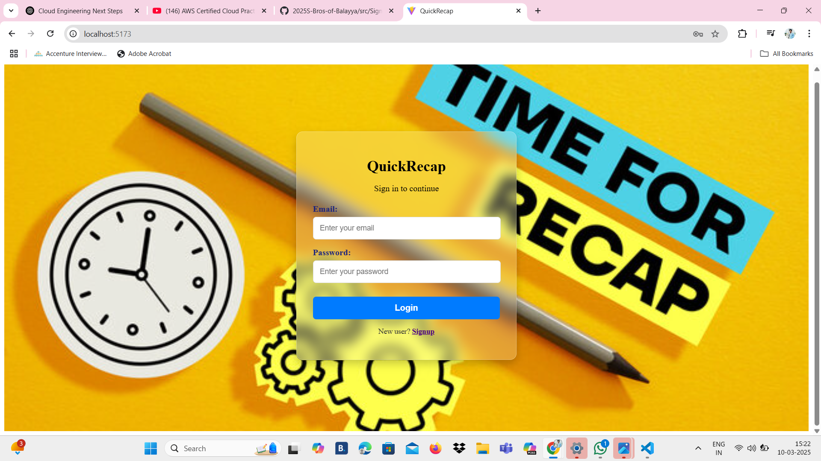
Figma Design

Slide 18
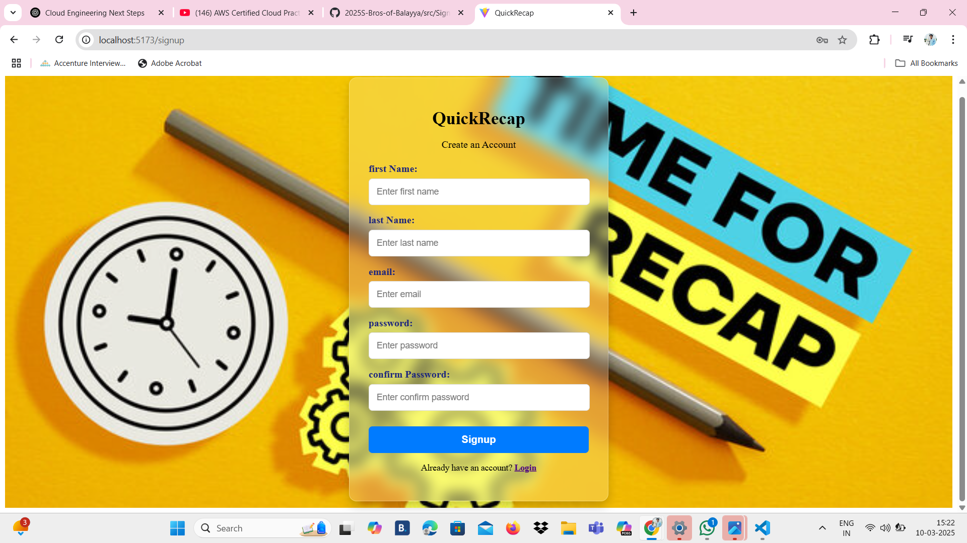
Figma Design

Slide 19
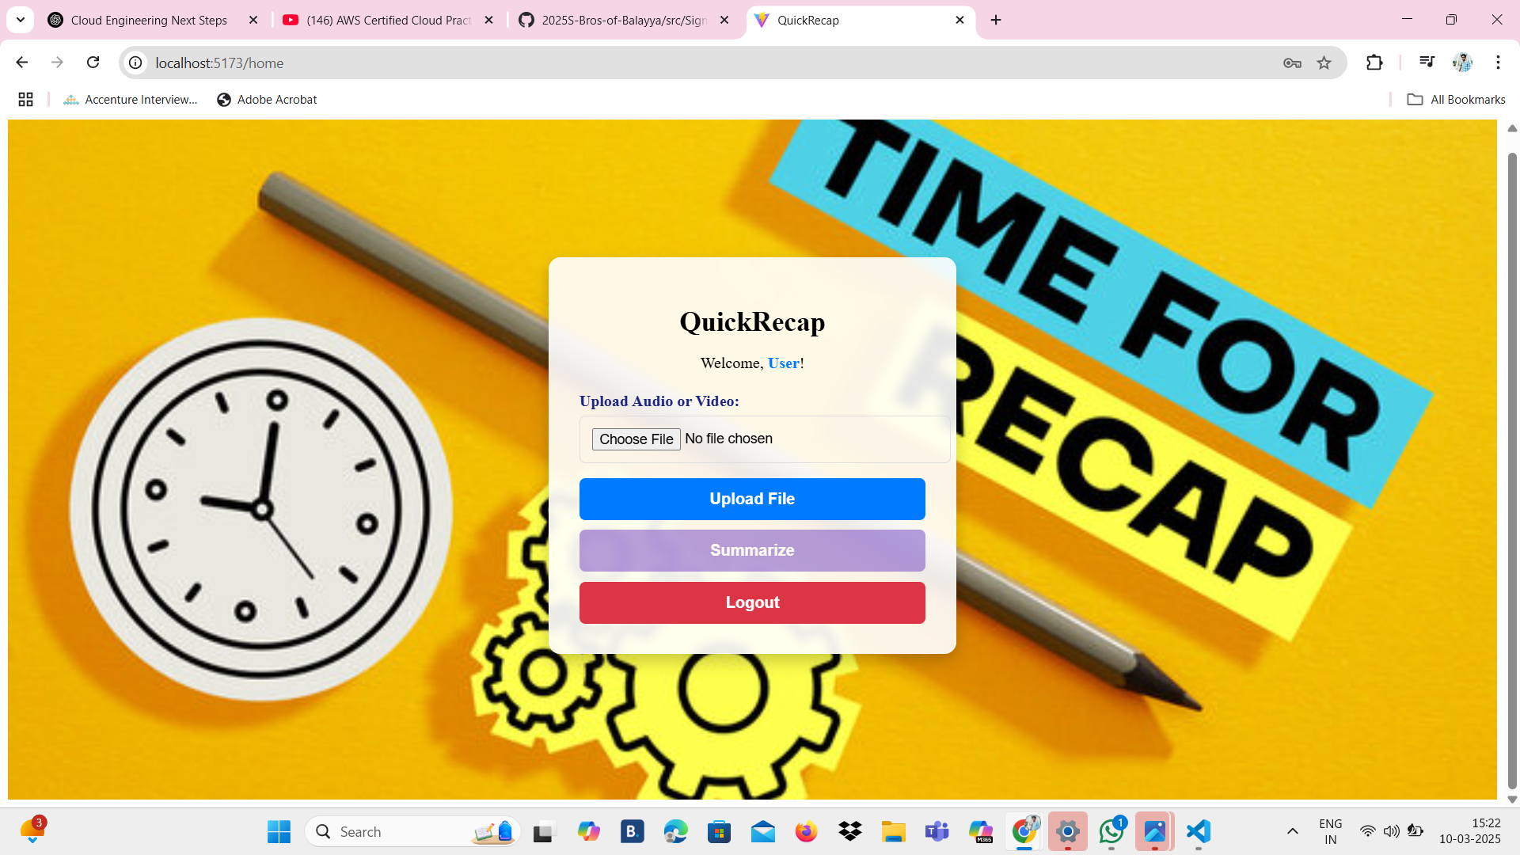
Figma Design

Slide 20
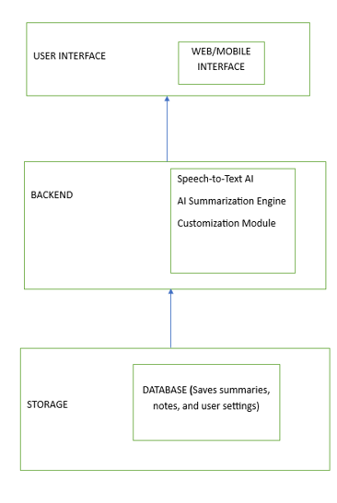
Architecture Diagram

Slide 21
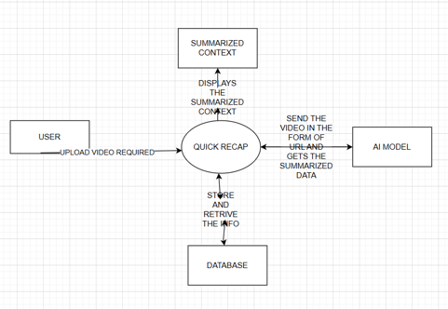
Context Diagram

Slide 22
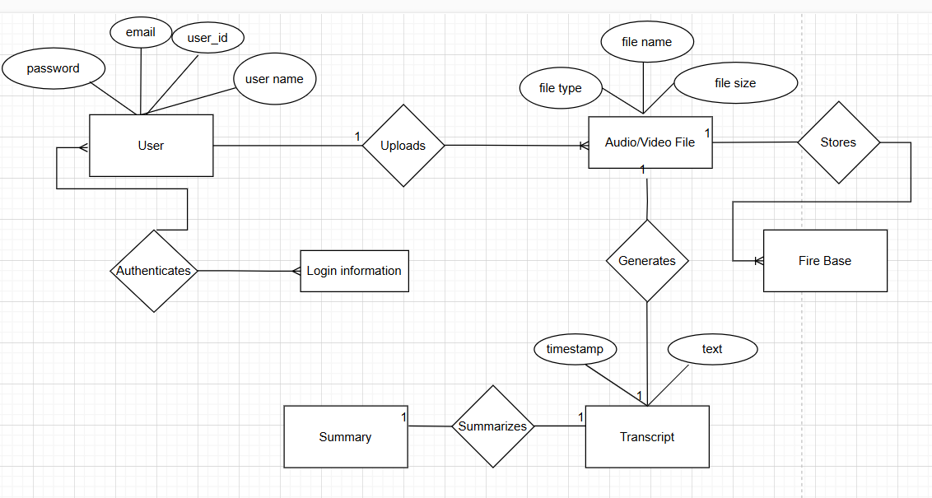
ER Diagram

Slide 23
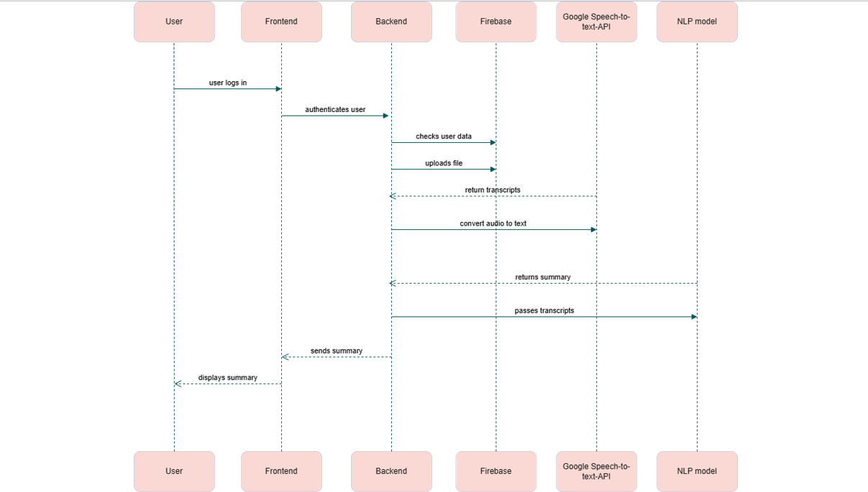
Sequence Diagram

Slide 24
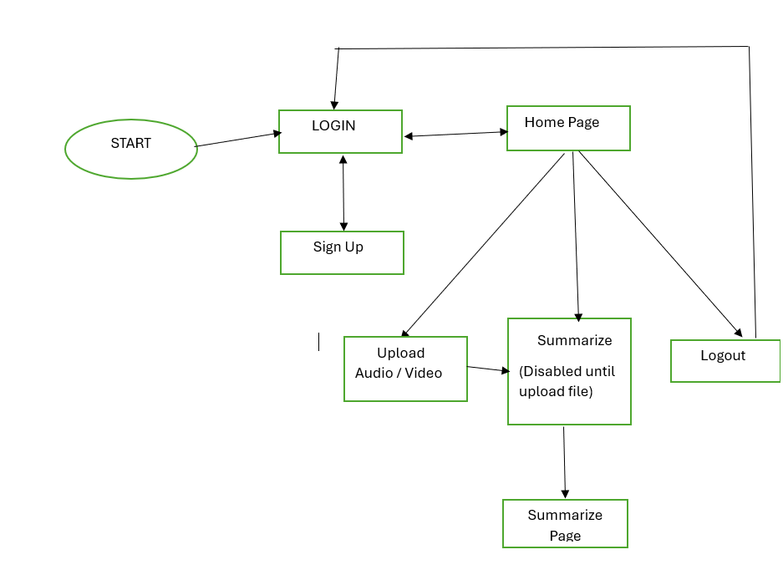
State Diagram

Slide 25
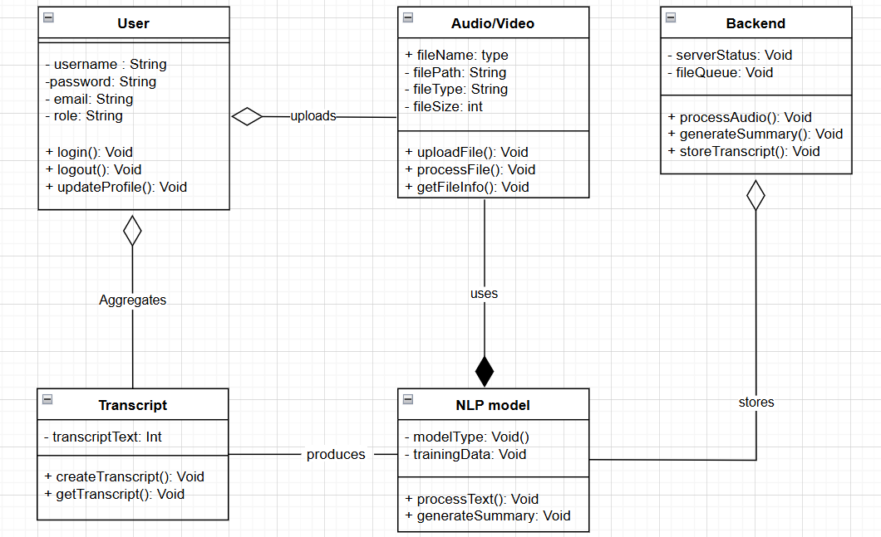
Class Diagram

Slide 26
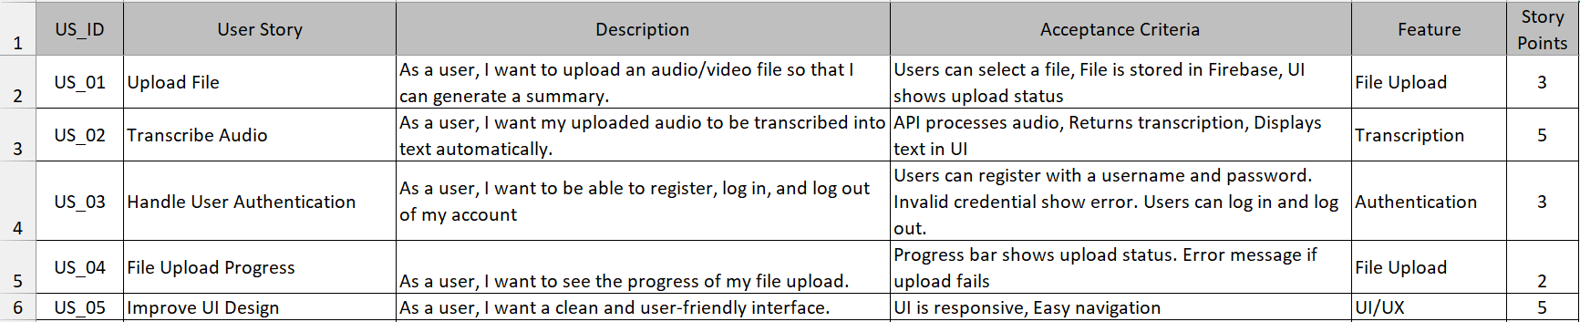
Product Backlog

Slide 27
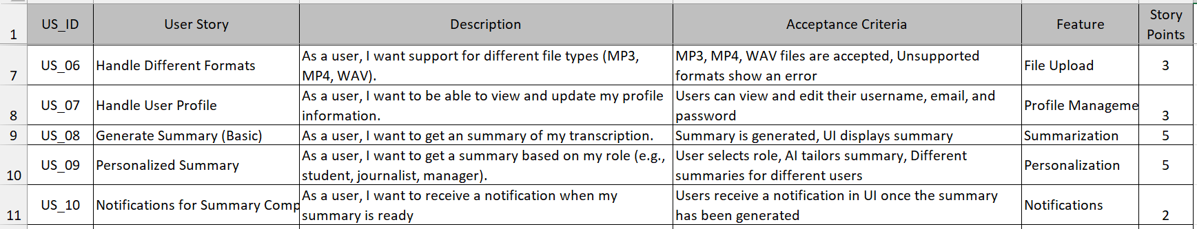
Product Backlog

Slide 28
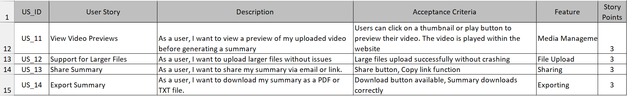
Product Backlog

Slide 29
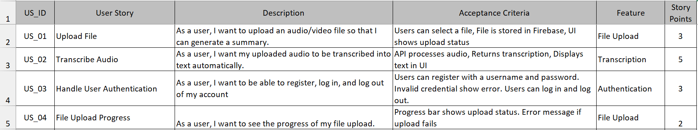
Sprint 1 User Stories

Slide 30
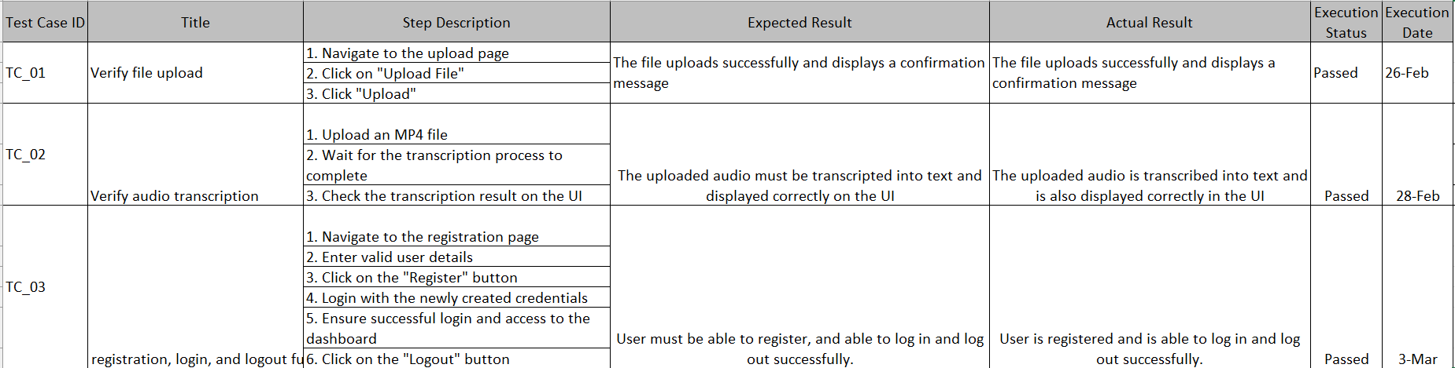
Test Cases

Slide 31
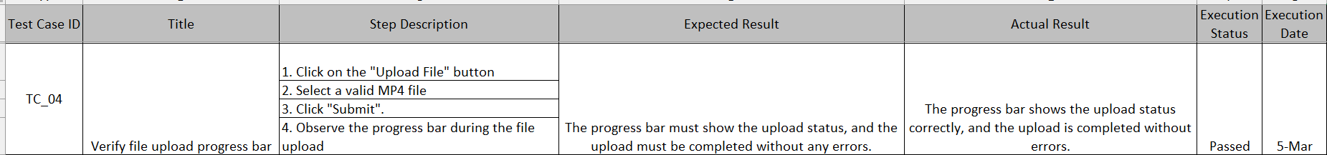
Test Cases

Slide 32
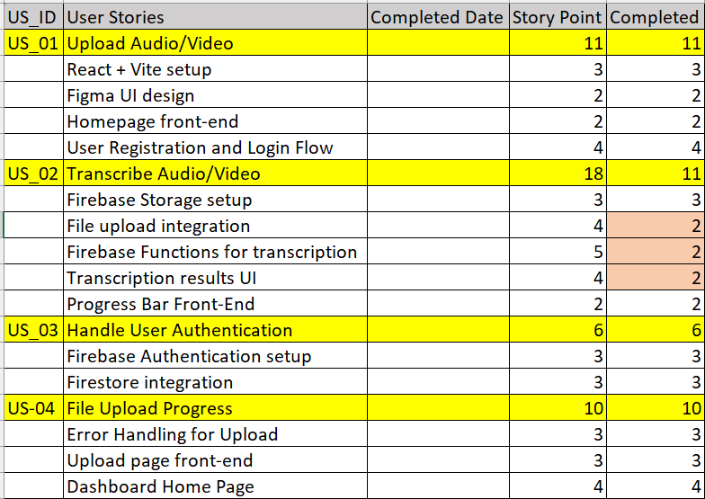
Sprint 1 Stories Completed / Not Completed

Slide 33
Metrics – Team Velocity
Sprint 1 velocity
Total story points: 45
Completed User Stories:
React + Vite setup - 3points
Figma UI design – 2 points
Homepage front-end – 2 points
User Registration and Login Flow – 4 points
Firebase Storage setup – 3 points
Progress Bar Front-End – 2 points
Firebase Authentication setup – 3 points
Firestore integration – 3 points
Error Handling for Upload – 3 points
Upload page front-end – 3 points
Dashboard Home Page – 3 points
Velocity: 45 story point completed

Slide 34
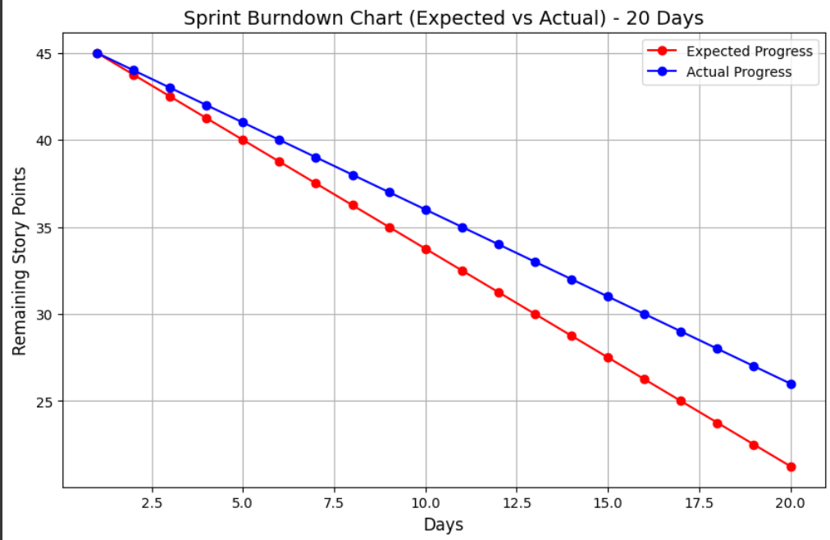
Metrics – Burndown Chart

Slide 35
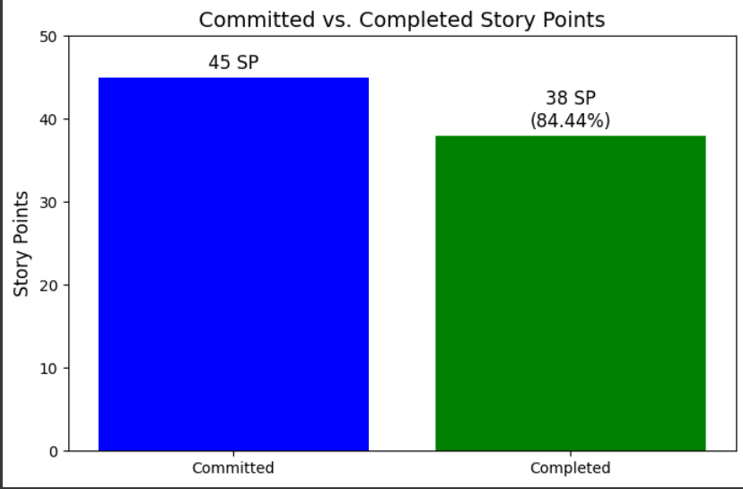
Metrics – Completed / Committed Ratio

Slide 36
Sprint 1 - Retrospective
What went well?
Good communication among team members
Successfully implemented the key features
Feedback / action items from previous sprint was worked on
Detailed user stories were finalized

Slide 37
Sprint 1 - Retrospective
What can be improved?
Jira needs to be updated more frequently
Tasks for sprint needs to be finalized at the beginning of the sprint
Communicate regularly and take others help more often. Address issues immediately as they arise
Follow sprint timelines

Slide 38
Sprint 1 - Retrospective
Action items
Assigned to everyone : Update jira as and when there is any progress for the tasks
Assigned to everyone : Inform the team about your schedule in advance
Assigned to Navya : Plan the tasks for sprint at the beginning of each sprint
Assigned to everyone : Review and test the code as it is developed

Slide 39
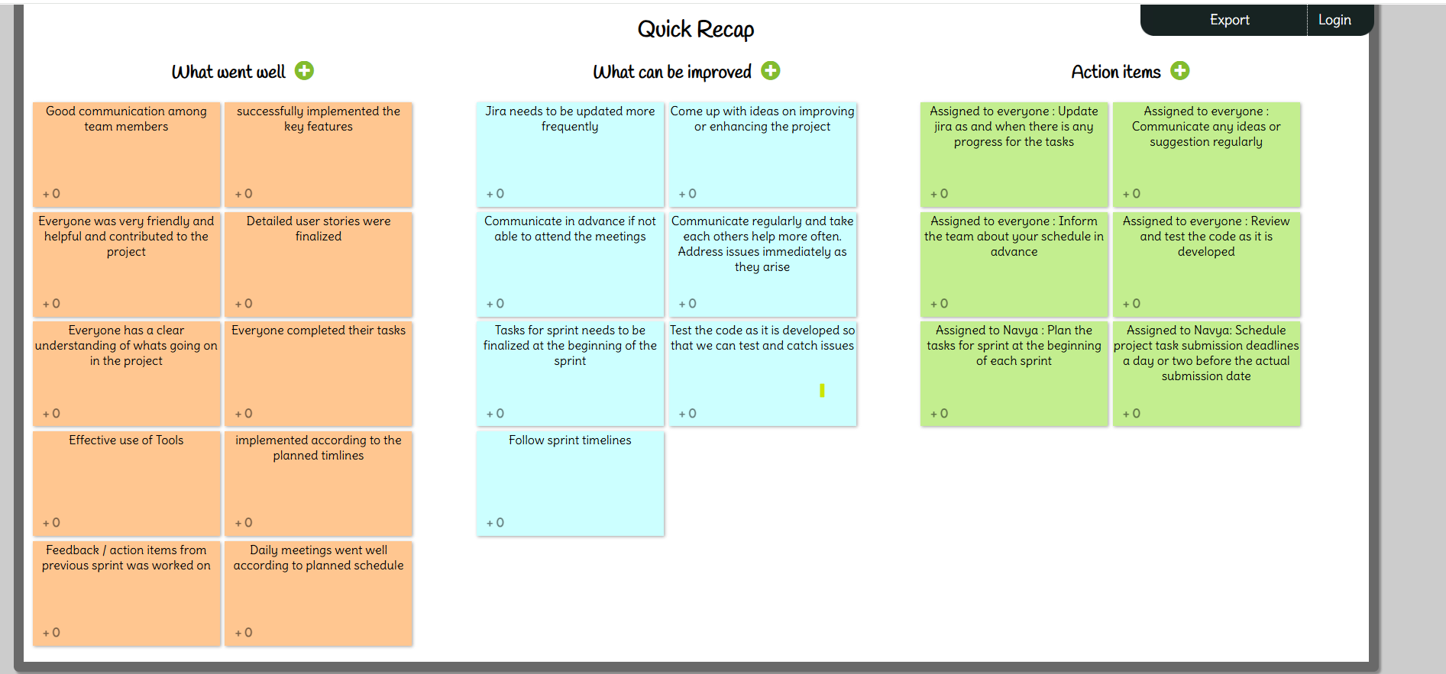
Sprint 1 - Retrospective

Slide 40
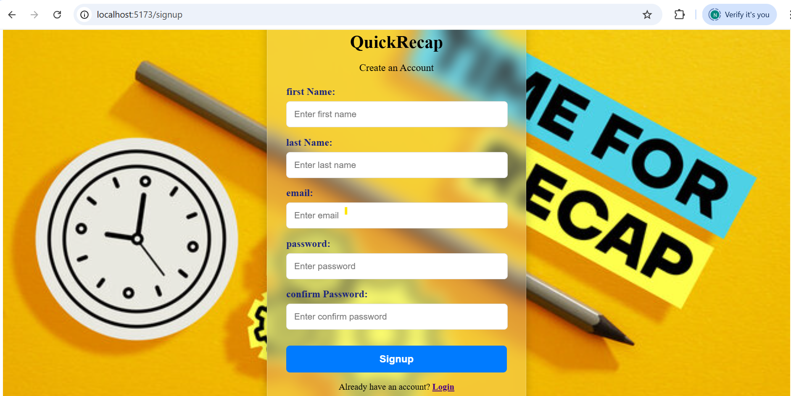
Sprint 1 - Project Demo

Slide 41
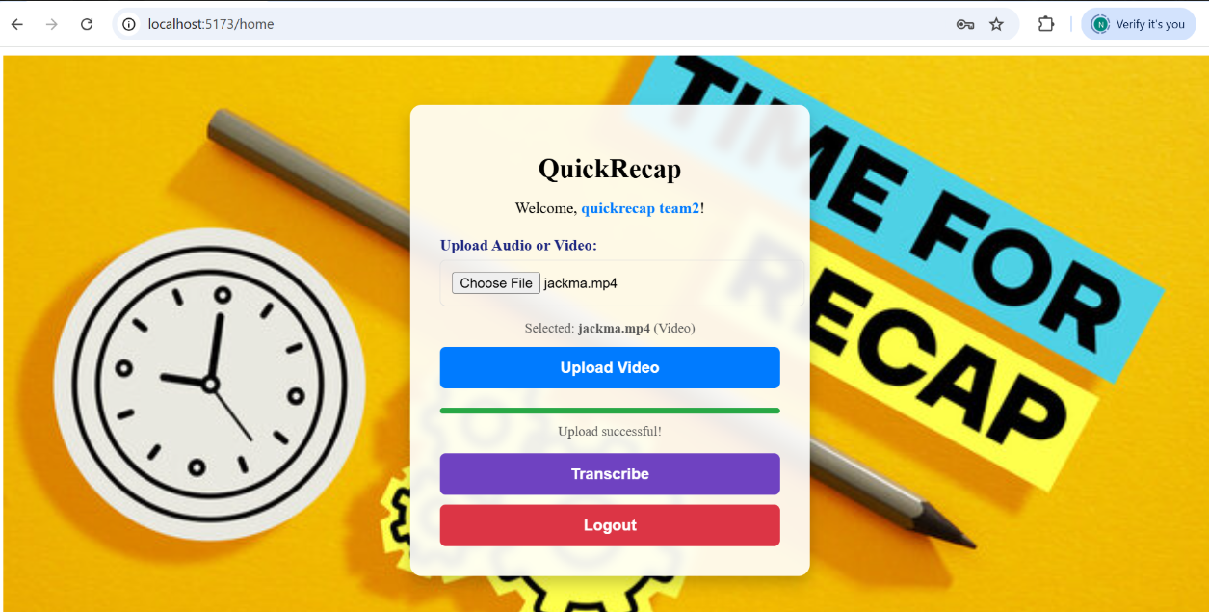
Sprint 1 - Project Demo

Slide 42
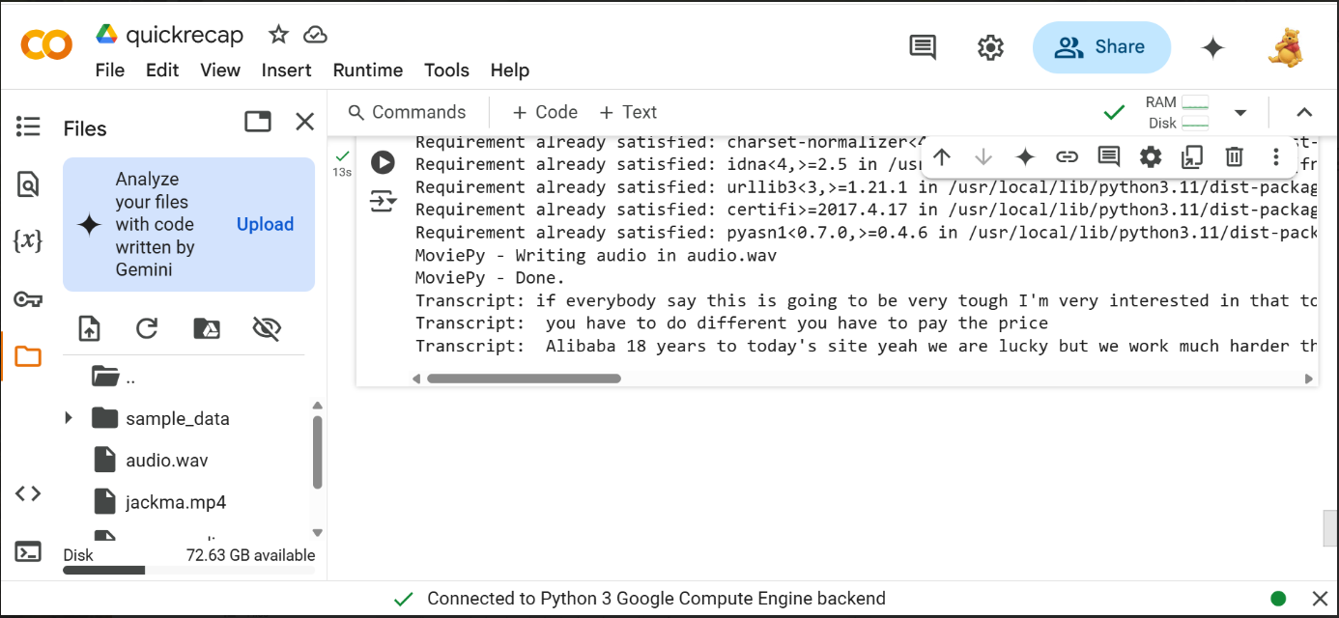
Sprint 1 - Project Demo

Slide 43
Wiki page Link
To see our progress visit the wiki page below:
https://github.com/htmw/2025S-Bros-of-Balayya/wiki

Slide 44
Live project demo

Slide 45
Thank You

